Slide 1
N Queen Problem
Presented By:
Shaykh Siddique
Moname Majumder
Anika Tabassum
Department of Computer Science and Engineering
East West University.

Slide 2
Overview
Introduction
What is N Queen problem
Basic Requirements
Applications
Use of N Queen problem
Algorithm
Pseudocode
How does it works (simulation)
Conclusions

Slide 3
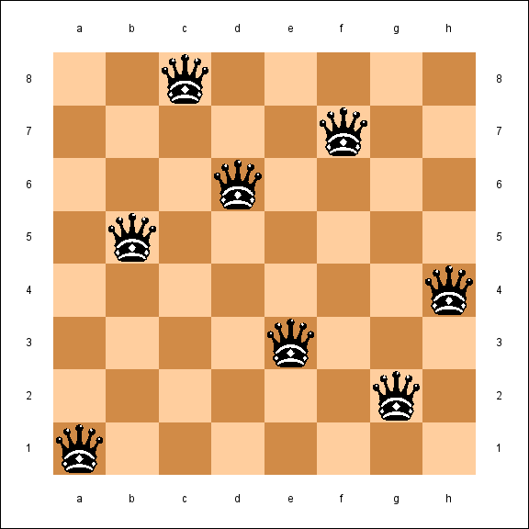
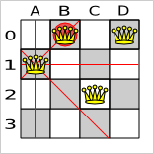
Problem Definition
The N Queen is the problem of placing N chess queens on an N×N chessboard so that no two queens attack each other.
Queen can attack on the same row , same column or diagonally.
Queen’s attacking line
Wrong placement of Queen

Slide 4
Problem Definition
The N Queen is the problem of placing N chess queens on an N×N chessboard so that no two queens attack each other.
Queen can attack on the same row , same column or diagonally.
There could be many valid ways to fill a N×N chessboard.
8 × 8 Chessboard

Slide 5
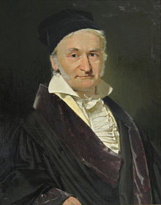
Problem Definition
The n-queens problem, originally introduced in 1850 by Carl Gauss, may be stated as follows: find a placement of n queens on an N×N chessboard, such that no one queen can be taken by any other.
Johann Carl Friedrich Gauss
Johann Carl Friedrich Gauss (1777-1855) was a German mathematician who contributed significantly to many fields, including number theory, algebra, statistics, analysis, differential geometry, geodesy, geophysics, mechanics, electrostatics, magnetic fields, astronomy, matrix theory, and optics.

Slide 6
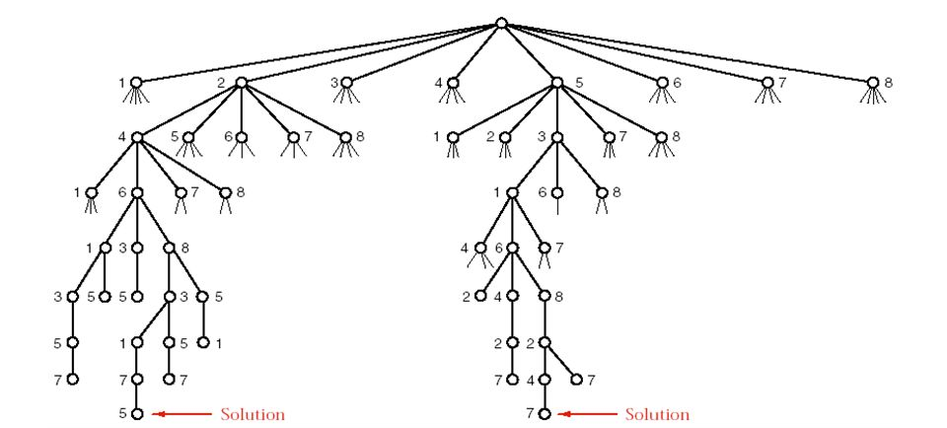
Basic Requirements
Part of the recursion tree for the N Queen Problem

Slide 7
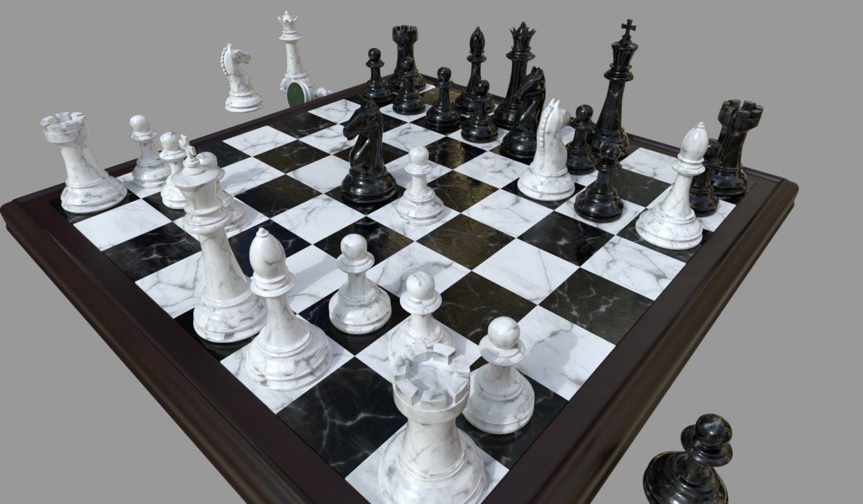
Applications
Board Game

Slide 8
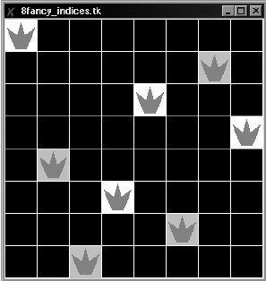
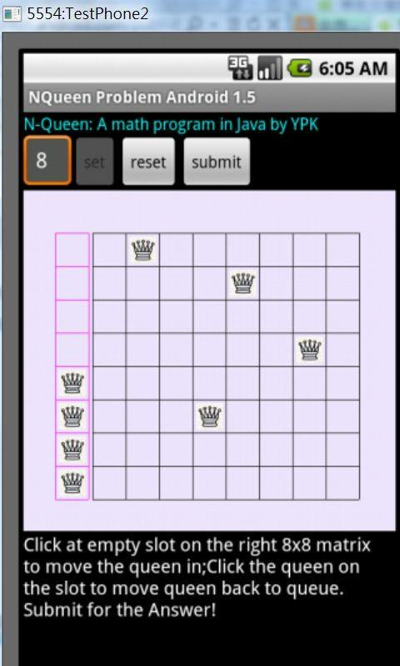
Applications
Board Game.
Applying in Game Developing.

Slide 9
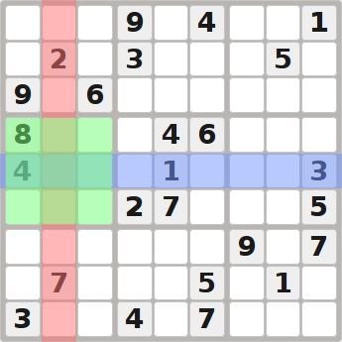
Applications
Board Game.
Applying in Game Developing.
Sudoku Solving.

Slide 10
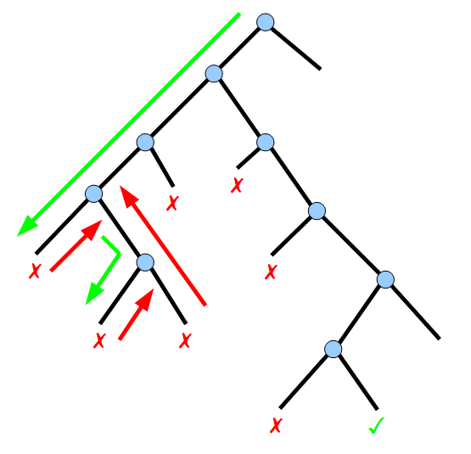
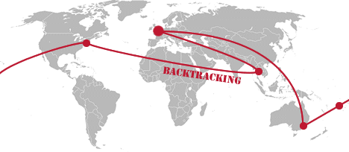
Applications
Board Game.
Applying in Game Developing.
Sudoku Solving.
A perfect example of backtracking problem.

Slide 11
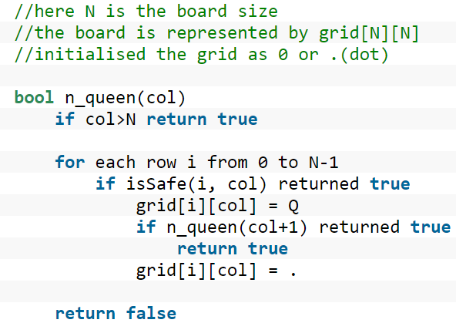
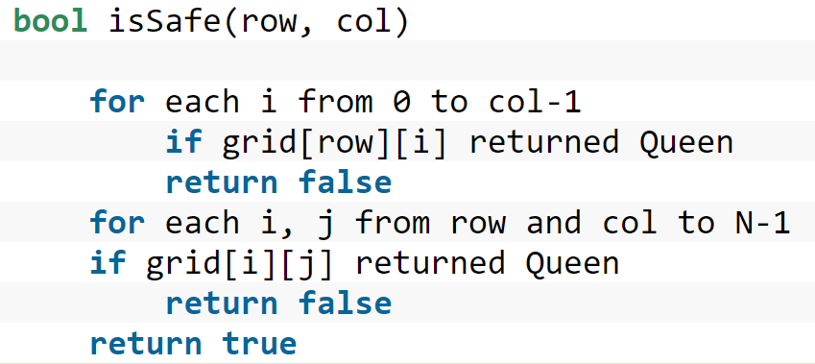
Algorithm
Pseudocode

Slide 12
N Queens
Simulation of 4×4 chessboard
Check validity of position (0, 0)
Columns | 0 | 1 | 2 | 3
r/c | 0 | 1 | 2 | 3
0 | 0 | 0 | 0 | 0
1 | 0 | 0 | 0 | 0
2 | 0 | 0 | 0 | 0
3 | 0 | 0 | 0 | 0
Safe movement
Rows | 0 | 1 | 2 | 3

Slide 13
N Queens
Simulation of 4×4 chessboard
Move a queen to (0, 0)
Columns | 0 | 1 | 2 | 3
r/c | 0 | 1 | 2 | 3
0 | 1 | 0 | 0 | 0
1 | 0 | 0 | 0 | 0
2 | 0 | 0 | 0 | 0
3 | 0 | 0 | 0 | 0
Rows | 0 | 1 | 2 | 3

Slide 14
N Queens
Simulation of 4×4 chessboard
Check validity of position (0, 1).
Columns | 0 | 1 | 2 | 3
r/c | 0 | 1 | 2 | 3
0 | 1 | 0 | 0 | 0
1 | 0 | 0 | 0 | 0
2 | 0 | 0 | 0 | 0
3 | 0 | 0 | 0 | 0
Not safe movement
Rows | 0 | 1 | 2 | 3

Slide 15
N Queens
Simulation of 4×4 chessboard
Check validity of position (1, 1).
Columns | 0 | 1 | 2 | 3
r/c | 0 | 1 | 2 | 3
0 | 1 | 0 | 0 | 0
1 | 0 | 0 | 0 | 0
2 | 0 | 0 | 0 | 0
3 | 0 | 0 | 0 | 0
Not safe movement
Rows | 0 | 1 | 2 | 3

Slide 16
N Queens
Simulation of 4×4 chessboard
Check validity of position (2, 1).
Columns | 0 | 1 | 2 | 3
r/c | 0 | 1 | 2 | 3
0 | 1 | 0 | 0 | 0
1 | 0 | 0 | 0 | 0
2 | 0 | 0 | 0 | 0
3 | 0 | 0 | 0 | 0
Safe movement
Rows | 0 | 1 | 2 | 3

Slide 17
N Queens
Simulation of 4×4 chessboard
Move a queen to (2, 1)
Columns | 0 | 1 | 2 | 3
r/c | 0 | 1 | 2 | 3
0 | 1 | 0 | 0 | 0
1 | 0 | 0 | 0 | 0
2 | 0 | 1 | 0 | 0
3 | 0 | 0 | 0 | 0
Rows | 0 | 1 | 2 | 3

Slide 18
N Queens
Simulation of 4×4 chessboard
Check validity of position (0, 2).
Columns | 0 | 1 | 2 | 3
r/c | 0 | 1 | 2 | 3
0 | 1 | 0 | 0 | 0
1 | 0 | 0 | 0 | 0
2 | 0 | 1 | 0 | 0
3 | 0 | 0 | 0 | 0
Not safe movement
Rows | 0 | 1 | 2 | 3

Slide 19
N Queens
Simulation of 4×4 chessboard
Check validity of position (1, 2).
Columns | 0 | 1 | 2 | 3
r/c | 0 | 1 | 2 | 3
0 | 1 | 0 | 0 | 0
1 | 0 | 0 | 0 | 0
2 | 0 | 1 | 0 | 0
3 | 0 | 0 | 0 | 0
Not safe movement
Rows | 0 | 1 | 2 | 3

Slide 20
N Queens
Simulation of 4×4 chessboard
Check validity of position (2, 2).
Columns | 0 | 1 | 2 | 3
r/c | 0 | 1 | 2 | 3
0 | 1 | 0 | 0 | 0
1 | 0 | 0 | 0 | 0
2 | 0 | 1 | 0 | 0
3 | 0 | 0 | 0 | 0
Not safe movement
Rows | 0 | 1 | 2 | 3

Slide 21
N Queens
Simulation of 4×4 chessboard
Check validity of position (3, 2).
Columns | 0 | 1 | 2 | 3
r/c | 0 | 1 | 2 | 3
0 | 1 | 0 | 0 | 0
1 | 0 | 0 | 0 | 0
2 | 0 | 1 | 0 | 0
3 | 0 | 0 | 0 | 0
Rows | 0 | 1 | 2 | 3
Not safe movement

Slide 22
N Queens
Simulation of 4×4 chessboard
Columns | 0 | 1 | 2 | 3
r/c | 0 | 1 | 2 | 3
0 | 1 | 0 | 0 | 0
1 | 0 | 0 | 0 | 0
2 | 0 | 1 | 0 | 0
3 | 0 | 0 | 0 | 0
Rows | 0 | 1 | 2 | 3
Function cannot move a Queen for this column.
So it will return by backtracking.

Slide 23
N Queens
Simulation of 4×4 chessboard
Return to position (0, 2).
Columns | 0 | 1 | 2 | 3
r/c | 0 | 1 | 2 | 3
0 | 1 | 0 | 0 | 0
1 | 0 | 0 | 0 | 0
2 | 0 | 1 | 0 | 0
3 | 0 | 0 | 0 | 0
Not efficient movement.
Remove this queen.
Rows | 0 | 1 | 2 | 3

Slide 24
N Queens
Simulation of 4×4 chessboard
Check validity of position (3, 1).
Columns | 0 | 1 | 2 | 3
r/c | 0 | 1 | 2 | 3
0 | 1 | 0 | 0 | 0
1 | 0 | 0 | 0 | 0
2 | 0 | 0 | 0 | 0
3 | 0 | 0 | 0 | 0
Rows | 0 | 1 | 2 | 3
Safe movement

Slide 25
N Queens
Simulation of 4×4 chessboard
Move a queen to (3, 1)
Columns | 0 | 1 | 2 | 3
r/c | 0 | 1 | 2 | 3
0 | 1 | 0 | 0 | 0
1 | 0 | 0 | 0 | 0
2 | 0 | 0 | 0 | 0
3 | 0 | 1 | 0 | 0
Rows | 0 | 1 | 2 | 3

Slide 26
N Queens
Simulation of 4×4 chessboard
Check validity of position(0, 2)
Columns | 0 | 1 | 2 | 3
r/c | 0 | 1 | 2 | 3
0 | 1 | 0 | 0 | 0
1 | 0 | 0 | 0 | 0
2 | 0 | 0 | 0 | 0
3 | 0 | 1 | 0 | 0
Not safe movement
Rows | 0 | 1 | 2 | 3

Slide 27
N Queens
Simulation of 4×4 chessboard
Check validity of position(1, 2)
Columns | 0 | 1 | 2 | 3
r/c | 0 | 1 | 2 | 3
0 | 1 | 0 | 0 | 0
1 | 0 | 0 | 0 | 0
2 | 0 | 0 | 0 | 0
3 | 0 | 1 | 0 | 0
Safe movement
Rows | 0 | 1 | 2 | 3

Slide 28
N Queens
Simulation of 4×4 chessboard
Move a queen to (1, 2)
Columns | 0 | 1 | 2 | 3
r/c | 0 | 1 | 2 | 3
0 | 1 | 0 | 0 | 0
1 | 0 | 0 | 1 | 0
2 | 0 | 0 | 0 | 0
3 | 0 | 1 | 0 | 0
Rows | 0 | 1 | 2 | 3

Slide 29
N Queens
Simulation of 4×4 chessboard
Check validity of position(0, 3)
Columns | 0 | 1 | 2 | 3
r/c | 0 | 1 | 2 | 3
0 | 1 | 0 | 0 | 0
1 | 0 | 0 | 1 | 0
2 | 0 | 0 | 0 | 0
3 | 0 | 1 | 0 | 0
Not safe movement
Rows | 0 | 1 | 2 | 3

Slide 30
N Queens
Simulation of 4×4 chessboard
Check validity of position(1, 3)
Columns | 0 | 1 | 2 | 3
r/c | 0 | 1 | 2 | 3
0 | 1 | 0 | 0 | 0
1 | 0 | 0 | 1 | 0
2 | 0 | 0 | 0 | 0
3 | 0 | 1 | 0 | 0
Not safe movement
Rows | 0 | 1 | 2 | 3

Slide 31
N Queens
Simulation of 4×4 chessboard
Check validity of position(2, 3)
Columns | 0 | 1 | 2 | 3
r/c | 0 | 1 | 2 | 3
0 | 1 | 0 | 0 | 0
1 | 0 | 0 | 1 | 0
2 | 0 | 0 | 0 | 0
3 | 0 | 1 | 0 | 0
Not safe movement
Rows | 0 | 1 | 2 | 3

Slide 32
N Queens
Simulation of 4×4 chessboard
Check validity of position(3, 3)
Columns | 0 | 1 | 2 | 3
r/c | 0 | 1 | 2 | 3
0 | 1 | 0 | 0 | 0
1 | 0 | 0 | 1 | 0
2 | 0 | 0 | 0 | 0
3 | 0 | 1 | 0 | 0
Rows | 0 | 1 | 2 | 3
Not safe movement

Slide 33
N Queens
Simulation of 4×4 chessboard
Columns | 0 | 1 | 2 | 3
r/c | 0 | 1 | 2 | 3
0 | 1 | 0 | 0 | 0
1 | 0 | 0 | 1 | 0
2 | 0 | 0 | 0 | 0
3 | 0 | 1 | 0 | 0
Rows | 0 | 1 | 2 | 3
Function cannot move a Queen for this column.
So it will return by backtracking.

Slide 34
N Queens
Simulation of 4×4 chessboard
Return to position (1, 2).
Columns | 0 | 1 | 2 | 3
r/c | 0 | 1 | 2 | 3
0 | 1 | 0 | 0 | 0
1 | 0 | 0 | 1 | 0
2 | 0 | 0 | 0 | 0
3 | 0 | 1 | 0 | 0
Not efficient movement.
Remove this queen.
Rows | 0 | 1 | 2 | 3

Slide 35
N Queens
Simulation of 4×4 chessboard
Check validity of position(2, 2)
Columns | 0 | 1 | 2 | 3
r/c | 0 | 1 | 2 | 3
0 | 1 | 0 | 0 | 0
1 | 0 | 0 | 0 | 0
2 | 0 | 0 | 0 | 0
3 | 0 | 1 | 0 | 0
Not safe movement
Rows | 0 | 1 | 2 | 3

Slide 36
N Queens
Simulation of 4×4 chessboard
Check validity of position(3, 2)
Columns | 0 | 1 | 2 | 3
r/c | 0 | 1 | 2 | 3
0 | 1 | 0 | 0 | 0
1 | 0 | 0 | 0 | 0
2 | 0 | 0 | 0 | 0
3 | 0 | 1 | 0 | 0
Rows | 0 | 1 | 2 | 3
Not safe movement

Slide 37
N Queens
Simulation of 4×4 chessboard
Columns | 0 | 1 | 2 | 3
r/c | 0 | 1 | 2 | 3
0 | 1 | 0 | 0 | 0
1 | 0 | 0 | 0 | 0
2 | 0 | 0 | 0 | 0
3 | 0 | 1 | 0 | 0
Rows | 0 | 1 | 2 | 3
Function cannot move a Queen for this column.
So it will return by backtracking.

Slide 38
N Queens
Simulation of 4×4 chessboard
Return to position (3, 1).
Columns | 0 | 1 | 2 | 3
r/c | 0 | 1 | 2 | 3
0 | 1 | 0 | 0 | 0
1 | 0 | 0 | 0 | 0
2 | 0 | 0 | 0 | 0
3 | 0 | 1 | 0 | 0
Not efficient movement.
Remove this queen.
Rows | 0 | 1 | 2 | 3

Slide 39
N Queens
Simulation of 4×4 chessboard
Columns | 0 | 1 | 2 | 3
r/c | 0 | 1 | 2 | 3
0 | 1 | 0 | 0 | 0
1 | 0 | 0 | 0 | 0
2 | 0 | 0 | 0 | 0
3 | 0 | 0 | 0 | 0
Rows | 0 | 1 | 2 | 3
Function cannot move a Queen for this column.
So it will return by backtracking.

Slide 40
N Queens
Simulation of 4×4 chessboard
Return to position (0, 0).
Columns | 0 | 1 | 2 | 3
r/c | 0 | 1 | 2 | 3
0 | 1 | 0 | 0 | 0
1 | 0 | 0 | 0 | 0
2 | 0 | 0 | 0 | 0
3 | 0 | 0 | 0 | 0
Not efficient movement.
Remove this queen.
Rows | 0 | 1 | 2 | 3

Slide 41
N Queens
Simulation of 4×4 chessboard
Check validity of position (1, 0)
Columns | 0 | 1 | 2 | 3
r/c | 0 | 1 | 2 | 3
0 | 0 | 0 | 0 | 0
1 | 0 | 0 | 0 | 0
2 | 0 | 0 | 0 | 0
3 | 0 | 0 | 0 | 0
Safe movement
Rows | 0 | 1 | 2 | 3

Slide 42
N Queens
Simulation of 4×4 chessboard
Check validity of position (0, 1)
Columns | 0 | 1 | 2 | 3
r/c | 0 | 1 | 2 | 3
0 | 0 | 0 | 0 | 0
1 | 1 | 0 | 0 | 0
2 | 0 | 0 | 0 | 0
3 | 0 | 0 | 0 | 0
Not safe movement
Rows | 0 | 1 | 2 | 3

Slide 43
N Queens
Simulation of 4×4 chessboard
Check validity of position (1, 1)
Columns | 0 | 1 | 2 | 3
r/c | 0 | 1 | 2 | 3
0 | 0 | 0 | 0 | 0
1 | 1 | 0 | 0 | 0
2 | 0 | 0 | 0 | 0
3 | 0 | 0 | 0 | 0
Not safe movement
Rows | 0 | 1 | 2 | 3

Slide 44
N Queens
Simulation of 4×4 chessboard
Check validity of position (2, 1)
Columns | 0 | 1 | 2 | 3
r/c | 0 | 1 | 2 | 3
0 | 0 | 0 | 0 | 0
1 | 1 | 0 | 0 | 0
2 | 0 | 0 | 0 | 0
3 | 0 | 0 | 0 | 0
Not safe movement
Rows | 0 | 1 | 2 | 3

Slide 45
N Queens
Simulation of 4×4 chessboard
Check validity of position (3, 1)
Columns | 0 | 1 | 2 | 3
r/c | 0 | 1 | 2 | 3
0 | 0 | 0 | 0 | 0
1 | 1 | 0 | 0 | 0
2 | 0 | 0 | 0 | 0
3 | 0 | 0 | 0 | 0
Rows | 0 | 1 | 2 | 3
Safe movement

Slide 46
N Queens
Simulation of 4×4 chessboard
Check validity of position (0, 2)
Columns | 0 | 1 | 2 | 3
r/c | 0 | 1 | 2 | 3
0 | 0 | 0 | 0 | 0
1 | 1 | 0 | 0 | 0
2 | 0 | 0 | 0 | 0
3 | 0 | 1 | 0 | 0
Safe movement
Rows | 0 | 1 | 2 | 3

Slide 47
N Queens
Simulation of 4×4 chessboard
Move a queen to (0, 2)
Columns | 0 | 1 | 2 | 3
r/c | 0 | 1 | 2 | 3
0 | 0 | 0 | 1 | 0
1 | 1 | 0 | 0 | 0
2 | 0 | 0 | 0 | 0
3 | 0 | 1 | 0 | 0
Rows | 0 | 1 | 2 | 3

Slide 48
N Queens
Simulation of 4×4 chessboard
Check validity of position (0, 3)
Columns | 0 | 1 | 2 | 3
r/c | 0 | 1 | 2 | 3
0 | 0 | 0 | 1 | 0
1 | 1 | 0 | 0 | 0
2 | 0 | 0 | 0 | 0
3 | 0 | 1 | 0 | 0
Not safe movement
Rows | 0 | 1 | 2 | 3

Slide 49
N Queens
Simulation of 4×4 chessboard
Check validity of position (1, 3)
Columns | 0 | 1 | 2 | 3
r/c | 0 | 1 | 2 | 3
0 | 0 | 0 | 1 | 0
1 | 1 | 0 | 0 | 0
2 | 0 | 0 | 0 | 0
3 | 0 | 1 | 0 | 0
Not safe movement
Rows | 0 | 1 | 2 | 3

Slide 50
N Queens
Simulation of 4×4 chessboard
Check validity of position (1, 3)
Columns | 0 | 1 | 2 | 3
r/c | 0 | 1 | 2 | 3
0 | 0 | 0 | 1 | 0
1 | 1 | 0 | 0 | 0
2 | 0 | 0 | 0 | 0
3 | 0 | 1 | 0 | 0
Safe movement
Rows | 0 | 1 | 2 | 3

Slide 51
N Queens
Simulation of 4×4 chessboard
Move a queen to (0, 2)
Columns | 0 | 1 | 2 | 3
r/c | 0 | 1 | 2 | 3
0 | 0 | 0 | 1 | 0
1 | 1 | 0 | 0 | 0
2 | 0 | 0 | 0 | 1
3 | 0 | 1 | 0 | 0
Rows | 0 | 1 | 2 | 3

Slide 52
N Queens
Simulation of 4×4 chessboard
One possible solution
r/c | 0 | 1 | 2 | 3
0 | 0 | 0 | 1 | 0
1 | 1 | 0 | 0 | 0
2 | 0 | 0 | 0 | 1
3 | 0 | 1 | 0 | 0

Slide 53
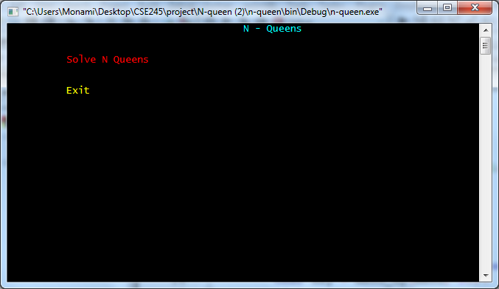
OUTPUT
Menue bar contains the option to input the number of board size.

Slide 54
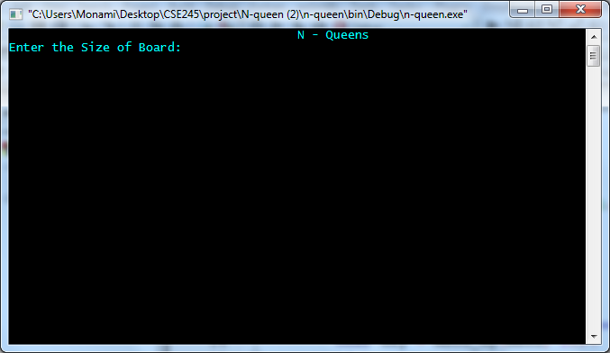
OUTPUT
Menue bar contains the option to input the number of board size.

Slide 55
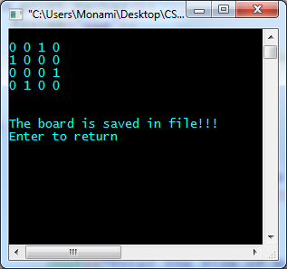
OUTPUT
1 denotes the positions of the queens
4X4 chess board

Slide 56
OUTPUT
1 denotes the positions of the queens
Different inputs results in different binary matrices
4X4 chess board

Slide 57
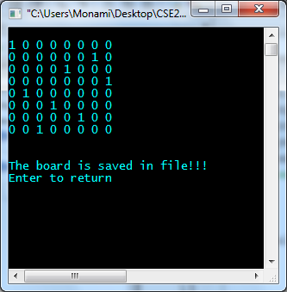
OUTPUT
1 denotes the positions of the queens
Different inputs results in different binary matrices
4X4 chess board
8X8 chess board

Slide 58
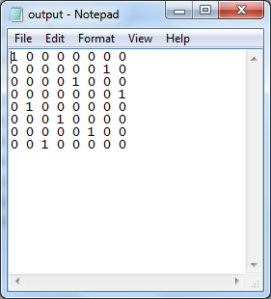
OUTPUT
Output is saved into a file
output in command prompt
output in file

Slide 59
COMPLEXITY ANALYSIS

Slide 60
COMPLEXITY ANALYSIS
O(N)

Slide 61
COMPLEXITY ANALYSIS
O(N*N)
O(N)
Notes:
For N queen problems, at first a function called with the column numbers and it goes to N recursively. For each number of column it checks the N rows, and for each rows it checks if the placing queen is safe or not. When all the column finishes, if the solution is not efficient then the function will backtrack to the previous step. So the complexity of this will be exponential, and finally for the worst case the complexity can be O (n!). For N queen problems, at first a function called with the column numbers and it goes to N recursively. For each number of column it checks the N rows, and for each rows it checks if the placing queen is safe or not. When all the column finishes, if the solution is not efficient then the function will backtrack to the previous step. So the complexity of this will be exponential, and finally for the worst case the complexity can be O (n!).

Slide 62
COMPLEXITY ANALYSIS
O(N)
O(N*N)
O(N)

Slide 63
COMPLEXITY ANALYSIS
O(N)
O(N*N)
O(N)
Running time: O(N!) BECAUSE OF BACKTRACKING

Slide 64
COMPLEXITY ANALYSIS
O(N)
O(N*N)
O(N)
This program requires trying all ppossible permutations. This results in such high complexity ( O(N!) )
Notes:
from the simulation, we can see it will try all possible permutation ... so the complexity is n!

Slide 65
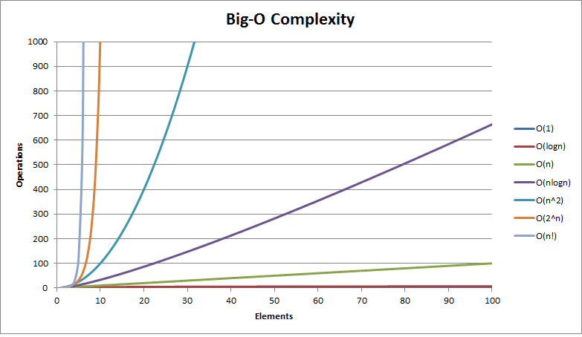
LIMITATIONS
The N-Queen problem has a very high complexity ( O(N!) ).
Notes:
from the simulation, we can see it will try all possible permutation ... so the complexity is n!

Slide 66
LIMITATIONS
The N-Queen problem has a very high complexity ( O(N!) ).
O(N!)
Notes:
from the simulation, we can see it will try all possible permutation ... so the complexity is n!

Slide 67
LIMITATIONS
The N-Queen problem has a very high complexity ( O(N!) ).
Because of this high complexity it takes a huge period of time to compile the code.
Notes:
from the simulation, we can see it will try all possible permutation ... so the complexity is n!

Slide 68
LIMITATIONS
The N-Queen problem has a very high complexity ( O(N!) ).
Because of this high complexity it takes a huge period of time to compile the code.
So this algorithm will not be an efficient one to use for something with large number of inputs
Notes:
from the simulation, we can see it will try all possible permutation ... so the complexity is n!

Slide 69
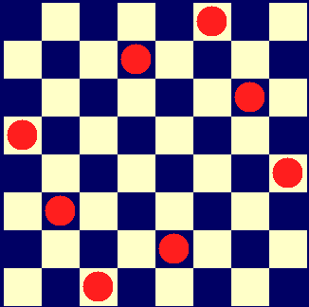
CONCLUSION
Though N-Queen problem has a very high complexity, it is very prominent problem
It is a great example of backtracking algorithm. Using this problem backtracking can be explained very easily.
Notes:
Though his nq problem has very high complexity, it is a crucial problem in algorithm. This this problem backtracking can be explained very easily.

Slide 70

Notes:
Though his nq problem has very high complexity, it is a crucial problem in algorithm. This this problem backtracking can be explained very easily.

Slide 71

Notes:
Though his nq problem has very high complexity, it is a crucial problem in algorithm. This this problem backtracking can be explained very easily.

